Slide 1
A Project Presentation On E-COMMERCE Group Members: ARGHADEEP BHOWMIK(05),GNIT ARNAB BANERJEE(06),GNIT MONISHANKAR NATH(16),GNIT MRIDUL KUMAR SAHA(18),GNIT PRATIK CHATTERJEE(21),GNIT PRITHWISH DAS(22),GNIT

Slide 2
ACKNOWLEDGEMENT We would like to take this opportunity to express our profound gratitude and deep regards to our project mentor, Mr. SUDEEP GHOSH, for his exemplary guidance, monitoring and constant encouragement throughout the course of this project. The blessing, help and guidance given by him, time to time, shall carry us a long way in the journey of life on which we are about to embark.

Slide 3
INTRODUCTION In our daily lives groceries are one of the most important need. WholeSale Bazar is an interactive e-commerce solution providing users with an opportunity to buy groceries. WholeSale Bazar is a online platform which deals with new groceries, we deliver a constructive service to each and every person all over India by providing them with an online platform where they can buy groceries for affordable price.

Slide 4
OBJECTIVE Online Shopping is the process whereby consumers directly buy goods and services without any intermediary service over the internet. The goal of this website is to develop a web based interface for all the people, the website would be easy to use and hence the shopping experience pleasant for the users. The main goal of this website is: To develop an easy to use web based interface where people can search for products (groceries), view a complete description of the product and order the product. All people can buy groceries from home.

Slide 5
SCOPE
The customers who wants to buy their desired items in bulk to sell to their own consumers, have to sign up in to our website.
The customers can choose their wanted items and can raise an enquiry as per their required wanting directly from the original manufacturer.
Manufactures can list their own items into website and can publish them directly into the home page.
Users doesn’t need to remember their passwords as they will be getting an OTP into their registered email address.
After placing the order customer will get the order id and all the confirmations into their registered email as well.

Slide 6
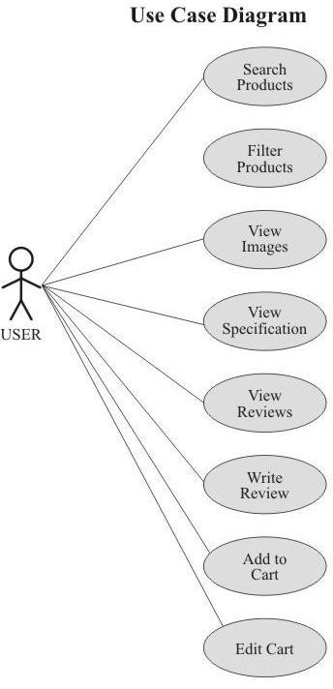
USE CASE DIAGRAM OF OUR APPLICATION

Slide 7
SNAPSHOTS OF OUR WEB APPLICATION PAGES

Slide 8
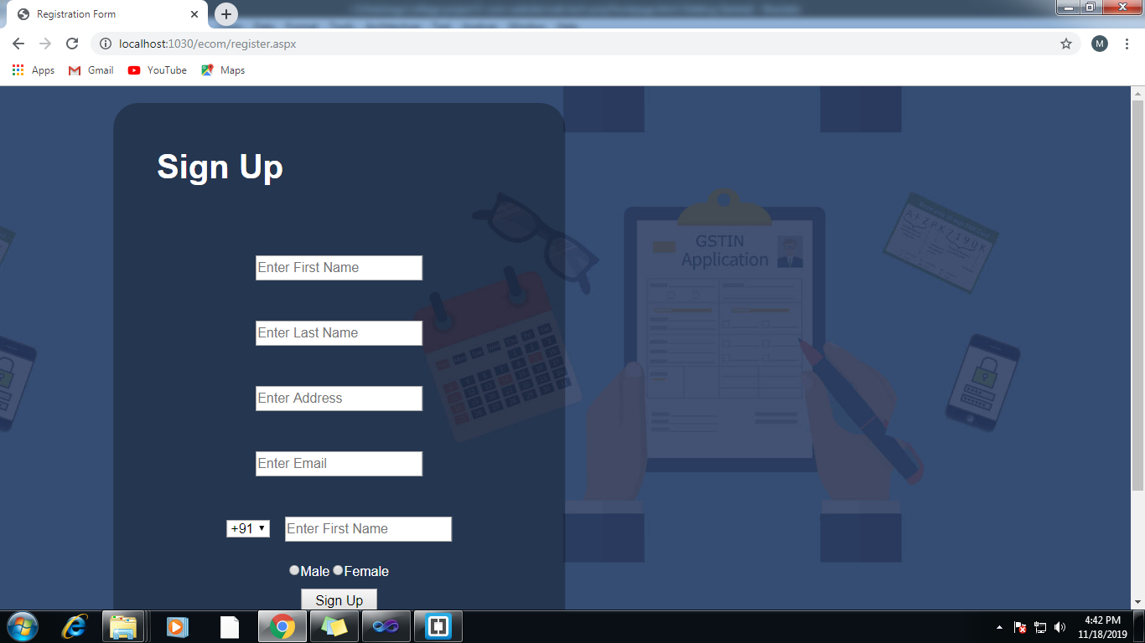

Slide 9
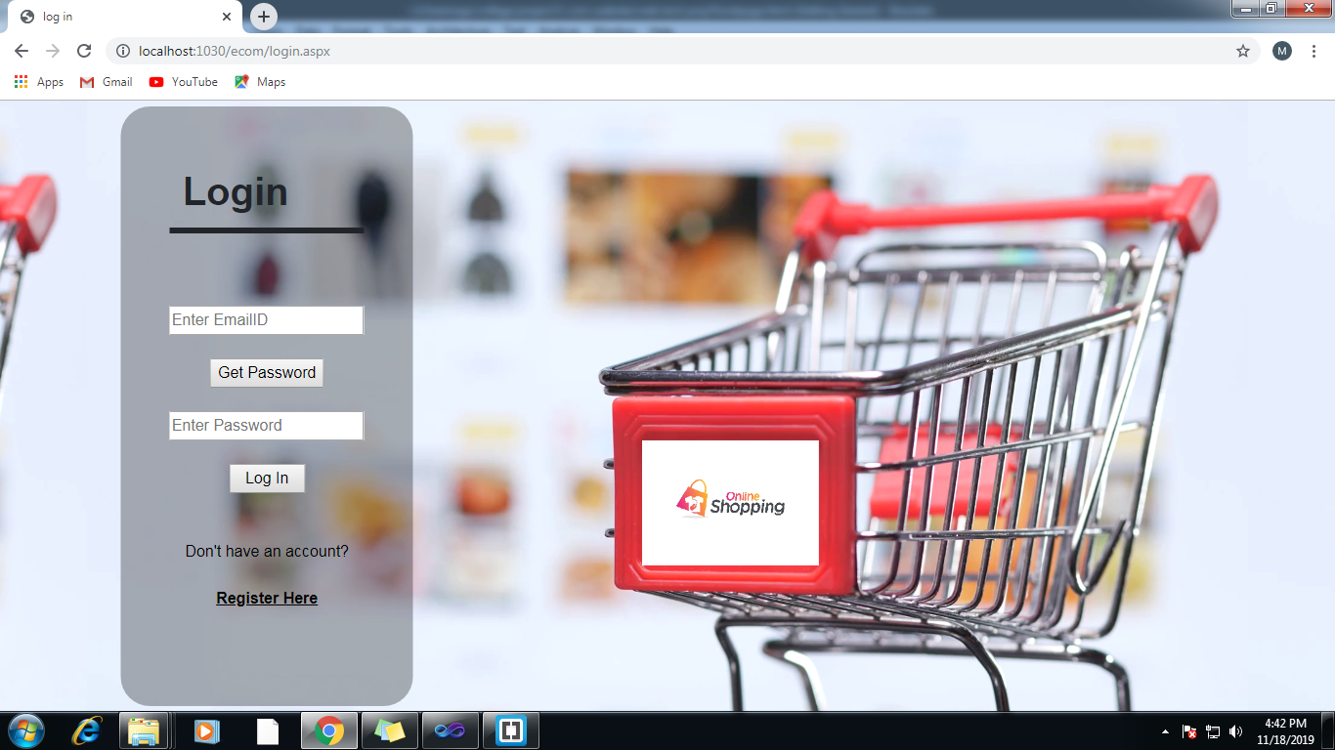

Slide 10
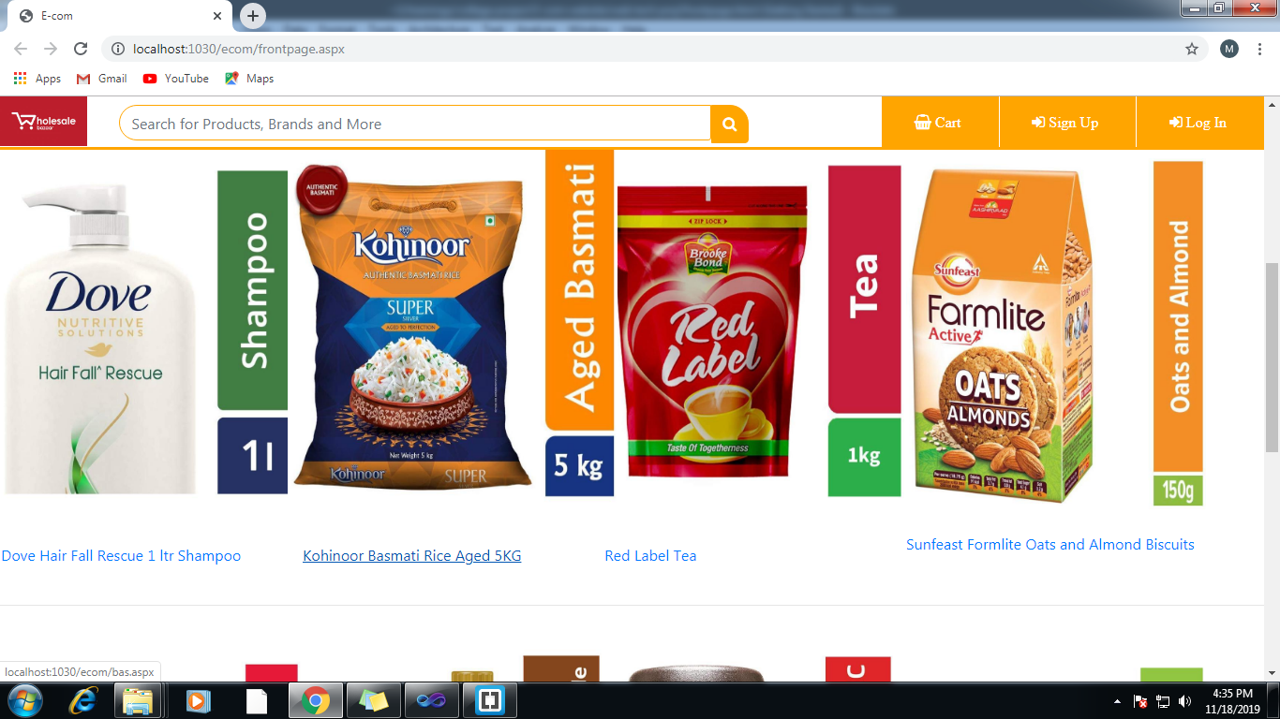

Slide 11
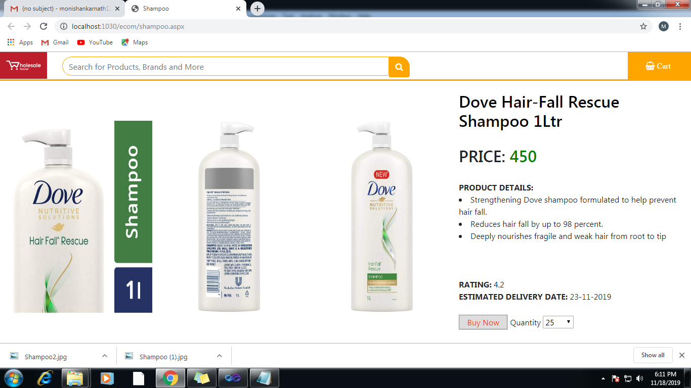

Slide 12
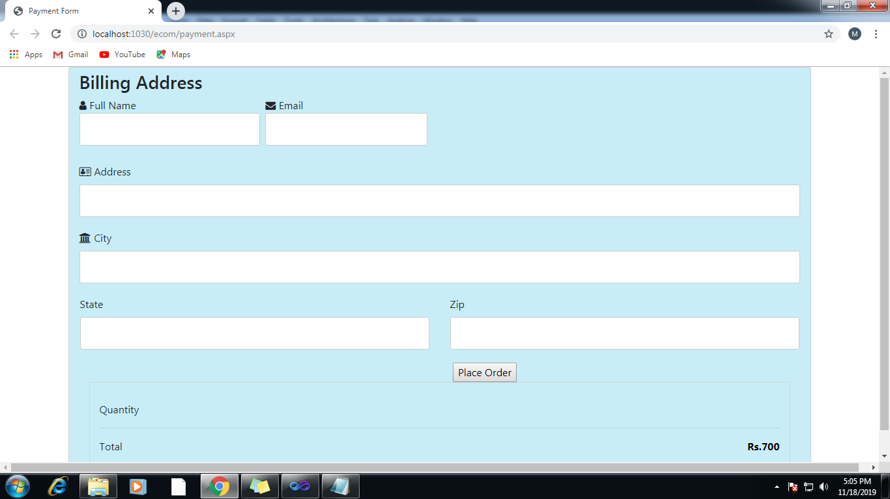

Slide 13
FUTURE SCOPE OF IMPROVEMENT
Manufactures section by which they can publish a post.
Another mail confirming all the order details will be sent automatically to the manufactures registered email address.
Admins can remove and advertise the paid promotions.

Slide 14
CONCLUSION We have successfully implemented the site ‘WholeSale Bazar’. With the help of various links and tools, we have been able to provide a site which will be live soon and running on the web. We have been successful in our attempt to take care of the needs of the user . Finally we hope that this will go a long way in popularizing.

Slide 15
THANK YOU!

